Slide 1
Overview of Neural Networks

Slide 2
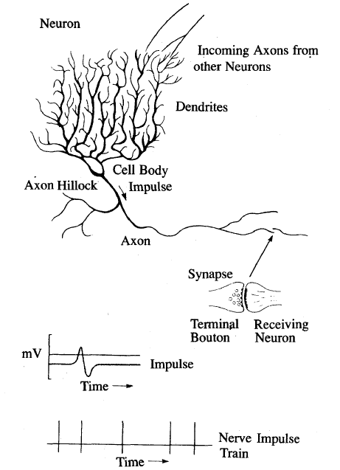
Biological Neuron (1)

Slide 3
Biological Neuron(2)
The neuron is able to respond to the total of its inputs aggregated within a short time interval called the period of latent summation. The neuron's response is generated if the total potential of its membrane reaches a certain level.
Incoming impulses can be excitatory if they cause the firing, or inhibitory if they hinder the firing of the response.
The neuron fires when the total of the weights to receive impulses exceeds the threshold value during the latent summation period.

Slide 4
Biological Neuron (3)
The characteristic feature of the biological neuron is that the signals generated do not differ significantly in magnitude. In other words, information is transmitted between the nerve cells by means of binary signals.
After carrying a pulse, an axon fiber is in a state of complete nonexcitability for a certain time called the refractory period.

Slide 5
McCulloch and Pitts Neurons (1943)
x₁
w₁
x₂
w₂
o
w_{m}
Τ
x_{m}
Greatly simplified biological neurons
Sum the inputs
If total is less than some threshold, neuron fires
Otherwise does not

Slide 6
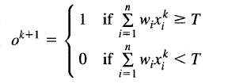
for some threshold Τ
The inputs x_{i}, i = 1,2, …, n, are 0 or 1
The weight w_{j} can be -1 or +1 (inhibitory or excitatory)
Use only a linear sum of inputs
No refractory period

Slide 7
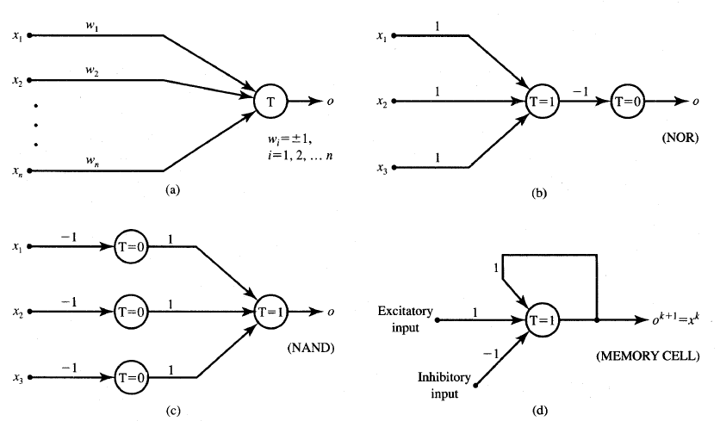
Elementary Logic Networks

Slide 8
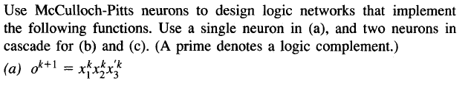

Exercises

Slide 9
Neural Networks
Can put lots of McCulloch & Pitts neurons together
Connect them up in any way we like
In fact, assemblies of the neurons are capable of universal computation (Turing machine)
Can perform any computation that a normal computer can
Just have to solve for all the weights w_{ij}
The John von Neumann computer = ALU + RAM
See: First Draft of a Report, by von Neumann,1945.

Slide 10
The Perceptron (Rosenblatt, 1957)
Weights and threshold are real numbers and are adjustable (not fixed).
The perceptron is an algorithm for supervised learning of binary classifiers (functions that can decide whether an input, represented by a vector of numbers, belongs to some specific class or not).
In 1958, The New York Times reported the perceptron to be "the embryo of an electronic computer that [the Navy] expects will be able to walk, talk, see, write, reproduce itself and be conscious of its existence.“ ☺

Slide 11
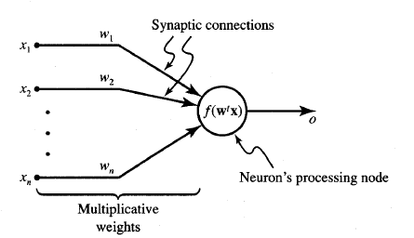


The Perceptron

Slide 12
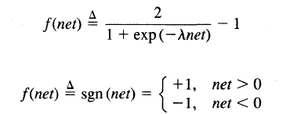
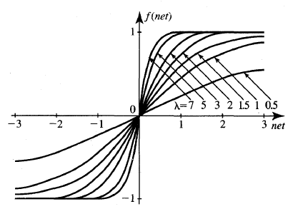
Bipolar Activation Function

Slide 13
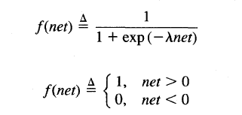
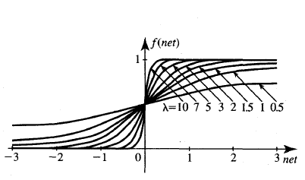
Unipolar Activation Function

Slide 14
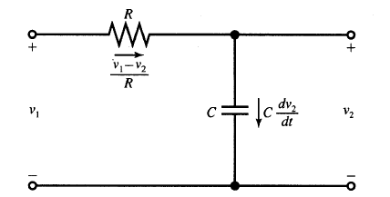
Continuous-time Neuron (resistance + capacitor)

Slide 15
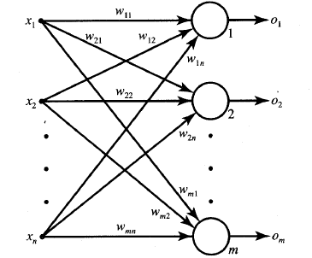
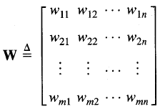
Feedforward Network

Slide 16
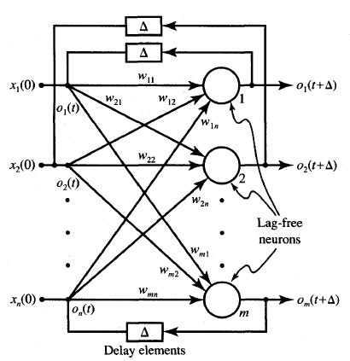
Feedback Network

Slide 17
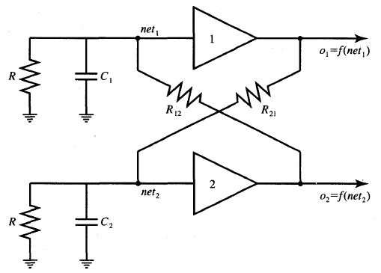
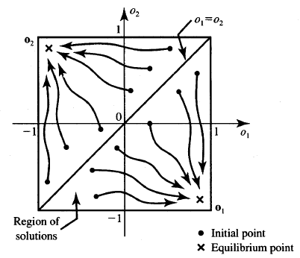
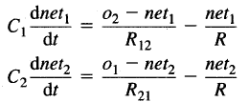
A Continuous-time Network

Slide 18
Training Neurons
Adapting the weights is learning
How does the network know it is right?
How do we adapt the weights to make the network right more often?
Training set with target outputs
Learning rule

Slide 19


Updating the Weights = Learning
We want to change the values of the weights
Aim: minimize the error at the output
If E = t-y, want E to be 0
Use:
Learning rate
Input
Error

Slide 20
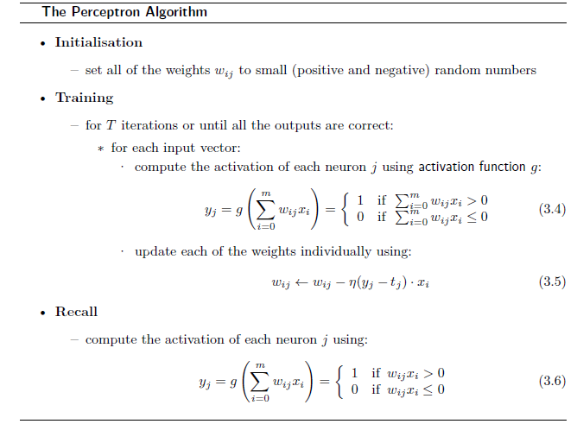
The Perceptron Learning Algorithm

Slide 21

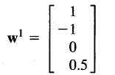


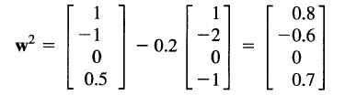

Example (1)
The teacher's desired responses for x₁, x₂, x₃ are: t₁ = -1, t₂ = -1, t₃ = 1. The learning rate is 0.1.
Step 1.
$$sgn\left(2.5\right)=1$$

Slide 22
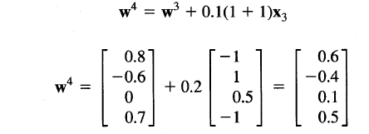




Example (2)
Step 2.
$net2=$ w^{2t} x₂ = -1.6
$$sgn\left(−1.6\right)=−1$$
Correction is not performed in this step since t₂ = - 1
Step 3.
$net3=$ w^{3t} x₃ = -2.1
$$sgn\left(−2.1\right)=−1$$
This terminates the sequence of learning steps unless the training set is recycled.

Slide 23
Example (3)
It is not a coincidence that the fourth component of x₁, x₂, and x₃ in this example is invariable and equal to -1. Perceptron learning requires fixing of one component of the input vector, although not necessarily at the -1 level.
By observing successive net values for continued training (by recycling the training set) we would see the trend of improving answers. Eventually, the network trained in this mode will stop committing any mistakes.
net⁴ = 0.9 obtained after three training steps as a response to resubmitted pattern x₁ is closer to net < 0 than the initial activation value in the first training step, net¹ = 2.5.

Slide 24
A Layer of Perceptrons
-1
Inputs
Outputs

Slide 25
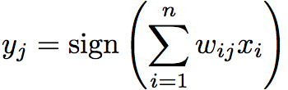
Linear Separability
Outputs are:

Slide 26
Linear Separability
w

Slide 27
Linear Separability
The Binary AND function

Slide 28
Limitations of the Perceptron
The Exclusive Or (XOR) function

Slide 29
Limitations of the Perceptron
W₁ > 0
W₂ > 0
W₁ + W₂ < 0
?

Slide 30
The Perceptron Convergence Theorem (Rosenblatt, 1962)
Given a linearly separable dataset for two classes, the perceptron will converge to a solution that separates the classes, and that it will do it after a finite number of iterations.
The theorem can be generalized for any number of classes, by using a layer of one perceptron per class.
The theorem can be used as a test for linear separability.
The number of iterations till convergence cannot be determined a priori.

Slide 31


Other Training Rules (1)
Hebbian
"When an axon of cell A is near enough to excite a cell B and repeatedly or persistently takes place in firing it, some growth process or metabolic change takes place in one or both cells such that A's efficiency, as one of the cells firing B, is increased." (Hebb 1949)
Delta
This rule parallels the discrete perceptron training rule.

Slide 32
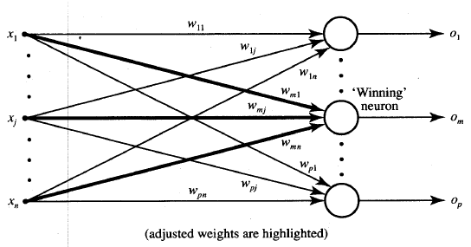



Other Training Rules (2)
Winner-Take-All

Slide 33
